Slide 1
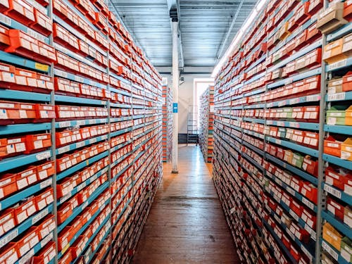
SOFATWRE PROJECT MANAGEMENT
Project: Inventory Management System(IMS)
Lecturer: IRAGENA Aimable
Date: 28/04/2026
Group Members:
MUTANGANA Joseph 29061
Musangwa Nshimiye Bennett 29092
Nshimyumuremyi Elie 26476
Shema Abdunur 28334

Slide 2
INTRODUCTION / PROBLEM
Introduction
The Inventory Management System (IMS) project is planned to fix problems in how businesses manage stock, track products, and keep inventory records.
Problem Statement
Inventory tracking is done manually
High risk of errors and delays
No real-time stock visibility
Leads to poor decision-making

Slide 3

PROJECT OBJECTIVES
Objectives: IMS
Improve inventory accuracy
Reduce stock shortages and overstock
Increase operational efficiency
Provide real-time reporting

Slide 4

PROPOSED SOLUTION
Solution: IMS
Centralized inventory system
Real-time stock tracking
Automated alerts
Reporting and analytics

Slide 5
In Scope
Inventory management
User authentication
Alerts and reports
Supplier tracking
Out of Scope
Mobile application
Enterprise Resources Planning integration
AI forecasting
PROJECT SCOPE

Slide 6
Core Features
User login & authentication
Add / Edit / Delete items
Stock tracking
Low-stock alerts
Report generation
User role management
KEY FEATURES (MOSCOW – MUST)

Slide 7

PROJECT TEAM
Project Team
Project Manager
Business Analyst
Lead Developer
Software Developer
UI/UX Designer
QA/Test Engineer

Slide 8
WBS: IMS
Planning
Requirements
Design
Development
Testing
Deployment
WORK BREAKDOWN STRUCTURE (WBS)

Slide 9
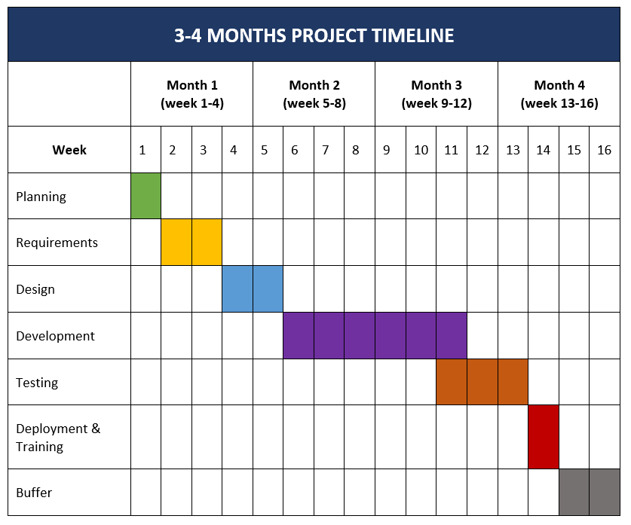
PROJECT TIMELINE

Slide 10
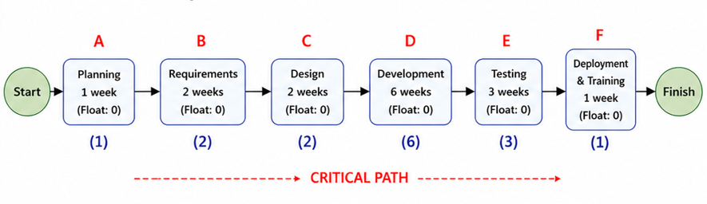
CRITICAL PATH
(15 Weeks)
“All activities are on the critical path, meaning any delay will directly affect the project completion.”

Slide 11

Negative Risks
Requirement misunderstanding
Development delays
System bugs
Stakeholder unavailability
Positive Risks
Availability of good tools.
Good team collaboration
Faster development
RISKS

Slide 12

EXPECTED OUTCOMES
Expected Results
Accurate inventory tracking
Reduced losses
Faster operations
Better decision-making

Slide 13

CONCLUSION
Conclusion
IMS solves critical inventory problems
Improves efficiency and accuracy
Delivered within 3–4 months timeline

Slide 14
END

